Slide 1
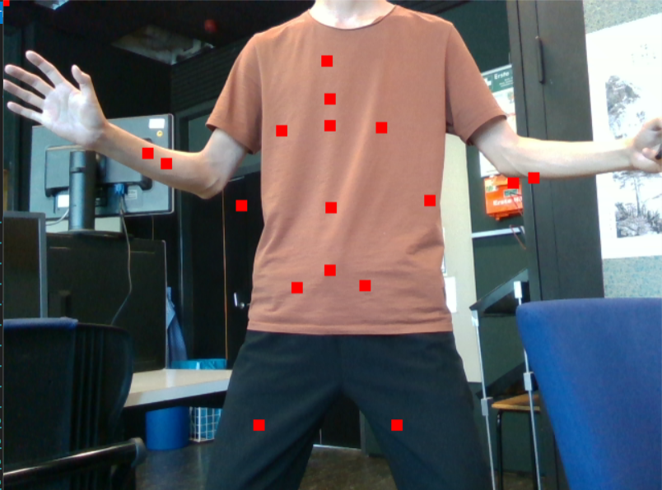
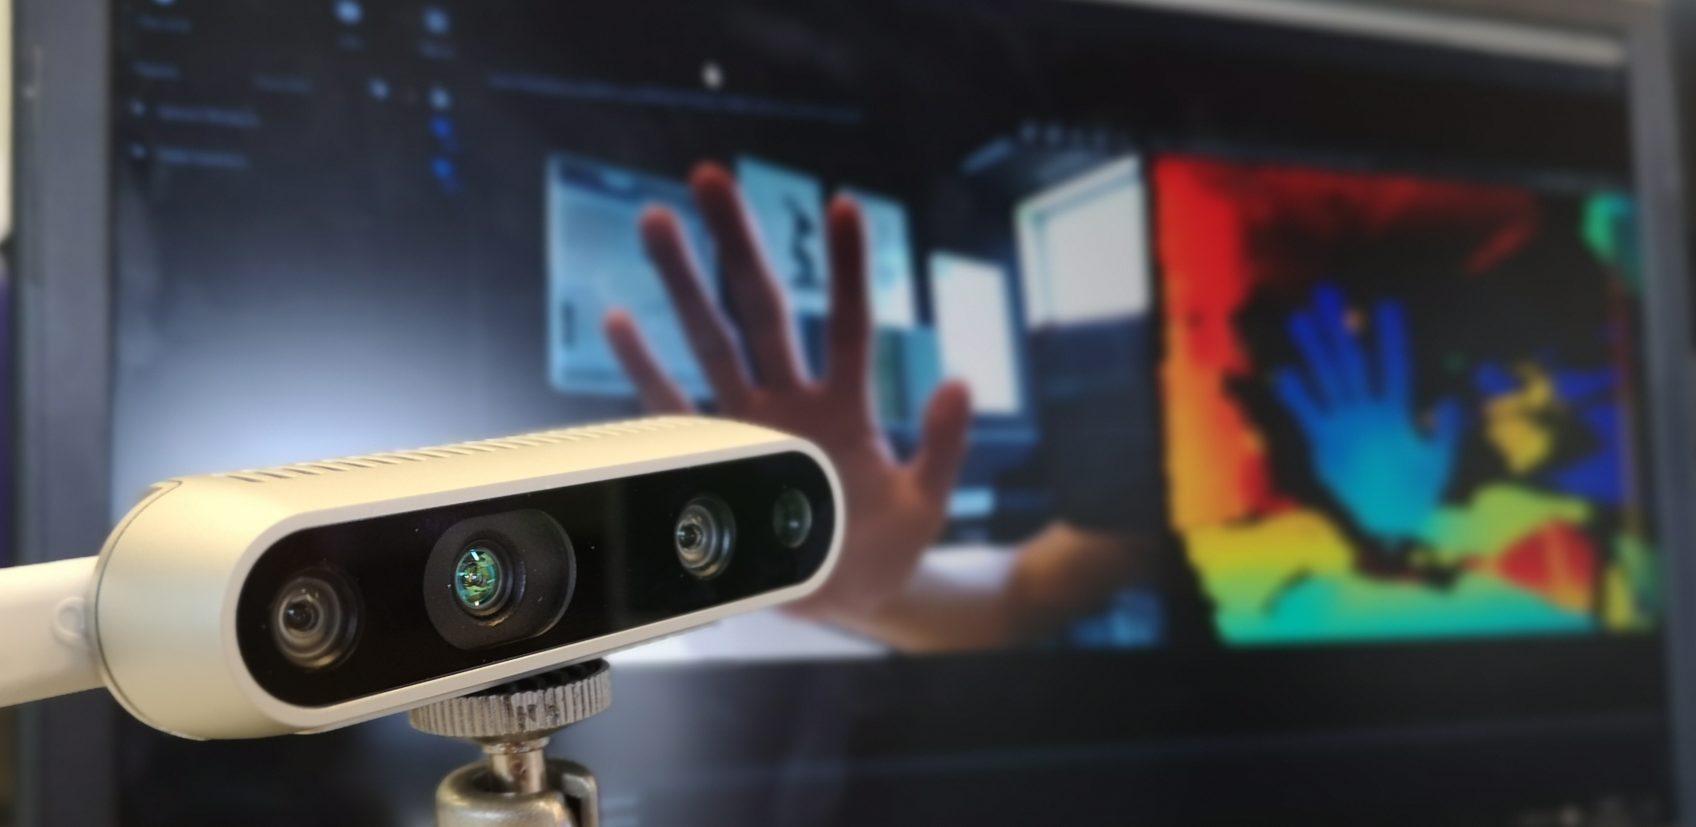
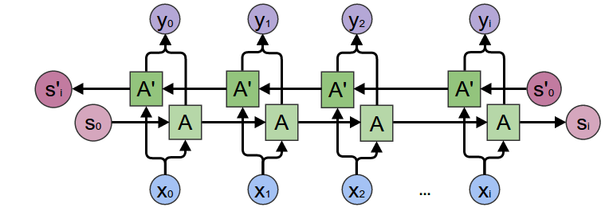
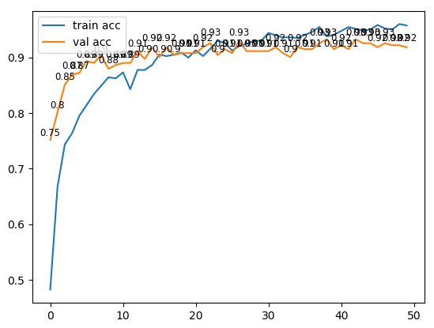
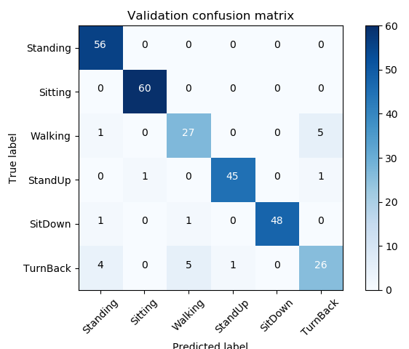
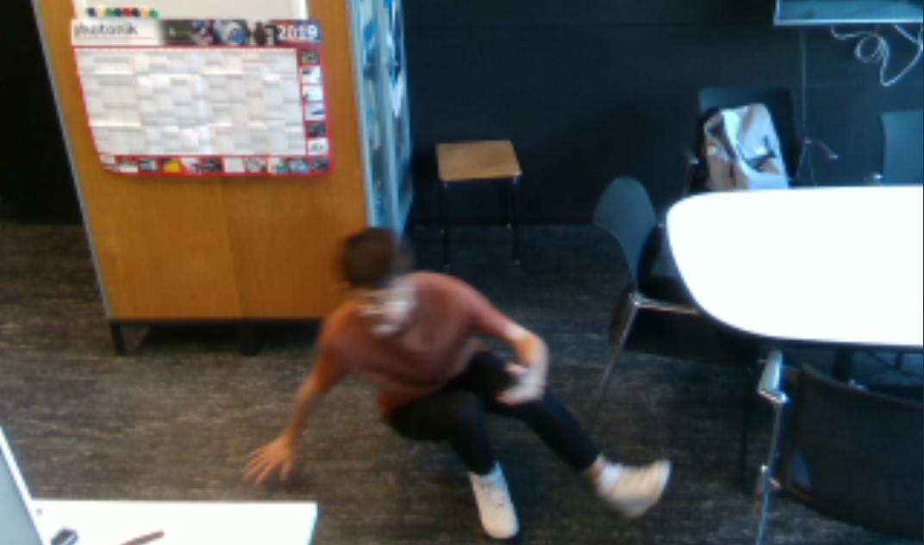
Deep Learning of Skeleton Features for Posture Recognition
Tianyu Zheng and Peter Ott
Mechatronics, Heilbronn University of Applied Sciences
Overview
Structure
Task:
Detect different posture of old man or children in the room with Depth Camera
Record new dataset, find an appropriate network
Approach:
Use Nuitrack SDK to do body skeletal tracking, get body joints data;
Input the joints to a neural network based on bidirectional LSTM (Long Short Term Memory) Network^{[1]};
Let the network predict the posture according to body joints;
Design different networks and compare performance between them;
Export the network and utilize it in a software framework.
Get video
Get joints
Process with BiLSTM
#Depth cam can detect object distance
#60 frames * 25 joints * 3 coordinates
#Bidirectional Long Short Term Memory
#Output: Posture Name (“Standing”)
Fig.1 Depth Camera
……
60 frames
#Input: 60*25*3 data
Label: Standing
Fig.3 BiLSTM^{[2]}
Fig.2 Grab frames
Dataset
Network
Train:Valid = 8:2
Train dataset:1127 samples
Valid dataset:282 samples
Each sample corresponds to one posture, like “Standing”, “Walking” or else.
Data in each sample
60 (60 frames) * 25 (25 joints) * 3 (3 coordinates) = 4500 values
Reshape each sample
Reshape each sample to 75*60
Network Structure
*Trainable params: 3,178,470
Optimizer
RMSprop, learning_rate=1e-4
Index | Name | BatchNorm | Dropout Rate | Activation | Units Number
1 | Dense | √ |  | ReLU | 32
2 | BiLSTM |  | 0.3 |  | 500*2
3 | Dense | √ | 0.1 | ReLU | 1024
4 | Dense | √ | 0.1 | ReLU | 512
5 | Dense |  |  | Softmax | 6 (classes)
60 time step
75 COOR
Performance
Conclusion
Final Accuracy: Around 93%
Validation Accuracy: 93%
Inference Speed: 0.047s/sample with GTX 1060
In Fig5, in the end of the training, there exists slightly over-fitting
In Fig6, “TurnBack” class sometimes seems very similar to “Standing ” or “Walking”, the dataset should be modified
Based on current dataset, the network achieves 93% accuracy. It’s not so high. There are still a lot of things to do.
Fig.4 Accuracy of train and valid during training
Fig.5 Confusion Matrix of Valid dataset
Plans
Reference
Record new dataset by fixing the camera in a high place
Try different networks and find a best one
Detect different postures (like falling) of old man or children
[1] Graves, Alex, and Jürgen Schmidhuber. "Framewise
phoneme classification with bidirectional LSTM and other
neural network architectures." Neural Networks 18.5-6
(2005): 602-610.
[2] Colah.github.io. (2019). Neural Networks, Types, and
Functional Programming -- colah's blog. [online] Available
at: http://colah.github.io/posts/2015-09-NN-Types-FP/
[Accessed 25 Jun. 2019].
Fig.6 Falling
tzheng@stud.hs-heilbronn.de; peter.ott@hs-heilbronn.de

